Slide 1
Intergenerational Mobility and Opportunity in the cities of the developing world
Jonas Jin
Princeton University
Brandon Joel Tan
Harvard University

Slide 2
Motivation 1
Rich literature on intergenerational income mobility in the developed world, but not so much on the developing world
  Previous studies study educational mobility
What does intergenerational mobility look like in the developing world?
How and why does it differ from the developed world?
  What kind of mechanisms are at play and how do they differ?
Understand the extent to which there are poverty traps in these countries and figure out how to help the poor break out of it
  Are certain groups particularly vulnerable?

Slide 3
Motivation 2
What is the relationship between cities and intergenerational mobility in the developing world?
There is a sizable urban-rural wage gap in developing countries.
  Place (Causal Effect) or People (Selection Bias)?
Can cities play a role in improving mobility among the poor in developing countries?
Macro Policy: Development associated with move out of agriculture. Can we speed up growth by moving people to the city?

Slide 4
Literature
Gollin, Lagakos, and Waugh (2014)
  Agricultural productivity gap of 3.5 across 151 countries
  Gap of 5.6 for countries in bottom quartile of income
  Adjusting for hours and human capital, become 2.2 and 3.0
Young (2013)
  Urban-Rural consumption gap of 4.5 among developing
  1 in 4 or 5 raised in rural/urban migrates
  Argues can all be explained by a model of selective migration
Hicks, Kleemans, Li, and Miguel (2017)
  Reproduce GLW in Kenya and Indonesia
  But, urban-rural gap goes away when control for individual FE

Slide 5
Literature
Alvarez (2017)
  Similar results in Brazil; Pulido and Swiecki (2018)
  Hicks et al. rely on recall data; creates bias
  Use FE but only current year income
  Find 33 and 8 log point premia for non-agriculture and urban
Chetty, Hendren, and Katz (2016)
  MTO affected kids but not parents
Bryan, Chowdhury, and Mobarak (2014)
  RCT incentivizing migration
  Treated households more likely to migrate as well as re-migrate
  Consistent with risky migration which requires individual-specific learning

Slide 6
Data: Indonesian Family Life Survey
On-going longitudinal survey containing individual- and household-level data for 30,000 individuals representative of 83% of the Indonesian population.
  Five waves conducted in 1993, 1997, 2000, 2007, and 2014
  Income history data for IFLS1, 2, and 3 (1990 – 2000)
Long-term panel survey of individuals, which allows for the tracking and comparison of parents and their children not only on the household level, but also on the individual level
  Many longitudinal surveys, especially in developing countries, only track households and thus cannot track individuals who leave
Rich data on income, location, education, migration, sector of work, and various other socioeconomic factors
High re-contact rate (among IFLS1 households, 87.8% were interviewed in all five waves or died)

Slide 7
Mobility in Indonesia
Relative Mobility
  Indonesia: .259
  US: .341
Absolute Mobility:
  Indonesia: 43.8
  US: ~43

Slide 8
Methods: Mobility of the Poor
One of our goals is to estimate mobility for particularly vulnerable populations, i.e. the poor in poor countries
  To compare within samples, a fixed income distribution doesn’t work
    Percentile buckets are differently sized
To test whether certain populations are more vulnerable, we take subsets of the data based on characteristics (e.g. agricultural jobs, rural location, high-education percentiles, etc.) and calculate income distributions for each characteristic
  Makes percentile buckets equally-sized
  Allows for more intuitive within-sample comparisons
Compare the mobility of those with below-median incomes to the rest in that subset to identify the most vulnerable

Slide 9
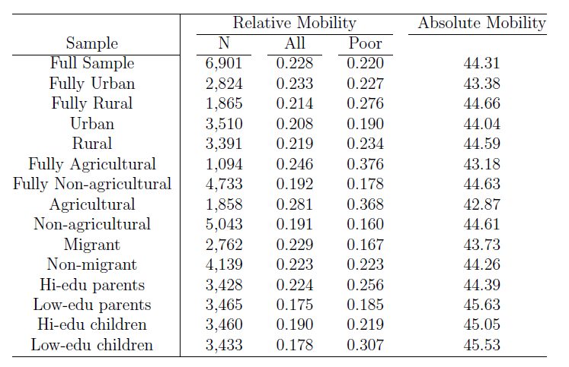
Methods: Mobility of the Poor

Slide 10
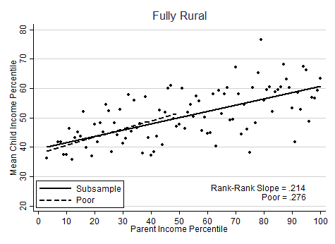
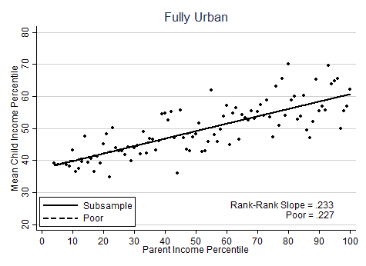
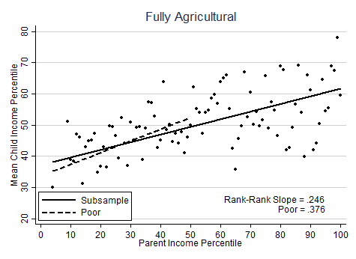
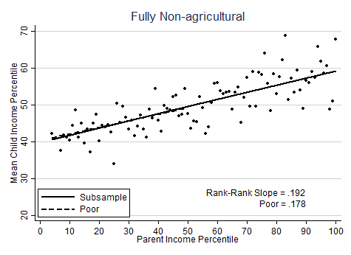
Results: Rural vs. Urban, Agricultural vs. Non-Agricultural

Slide 11
Observations
The rural and agricultural poor have much worse relative mobility—why?
Possible explanations
  Education
  Low physical and occupational mobility

Slide 12
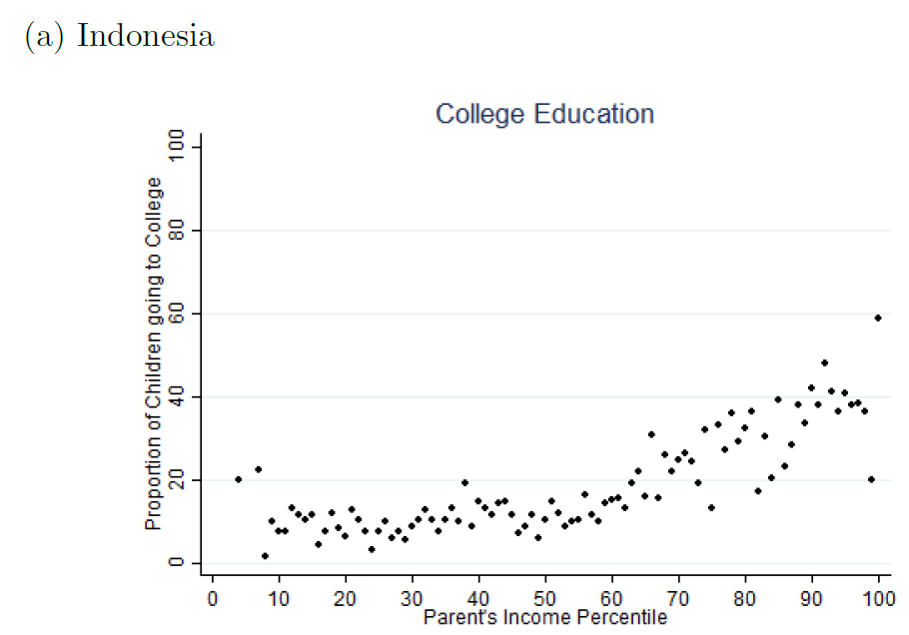
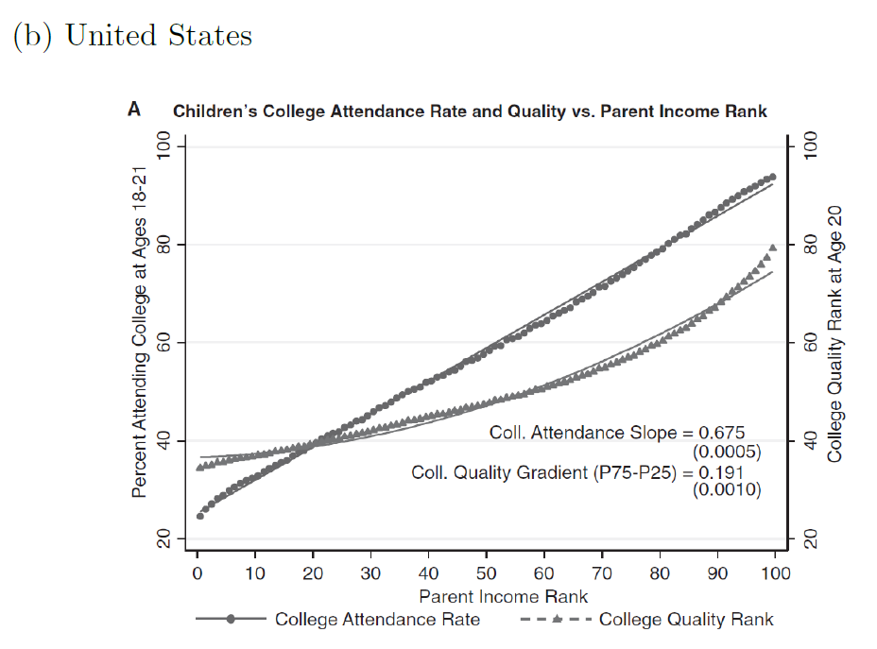

Observations—Education
College/higher education very much restricted to the country’s richest (even more than in the United States)

Slide 13
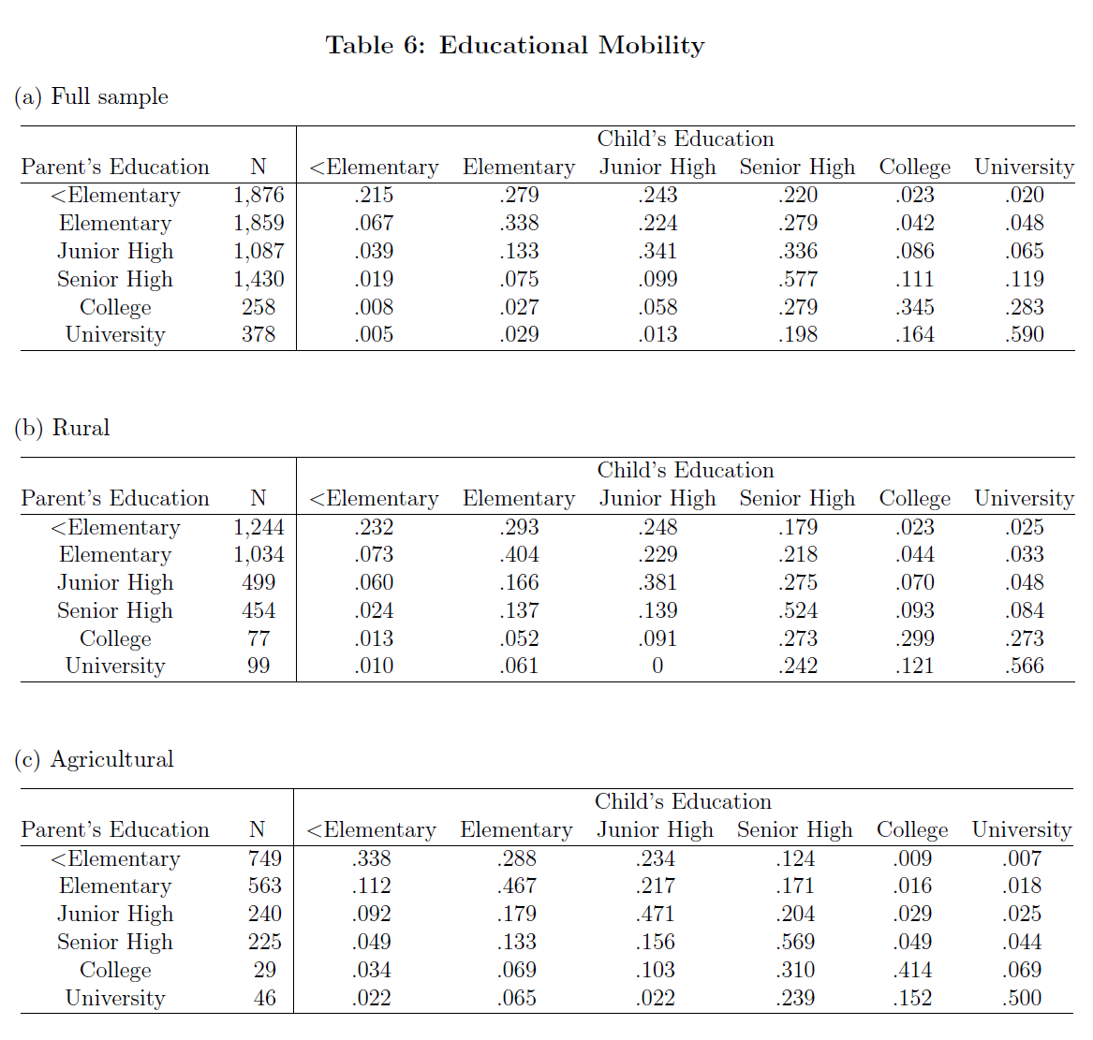
Observations—Education
Proportion receiving ≤ parent’s edu level
Conditional on parent’s edu ≤ elementary
=.49
=.31
=.47
=.34
=.56
=.44

Slide 14
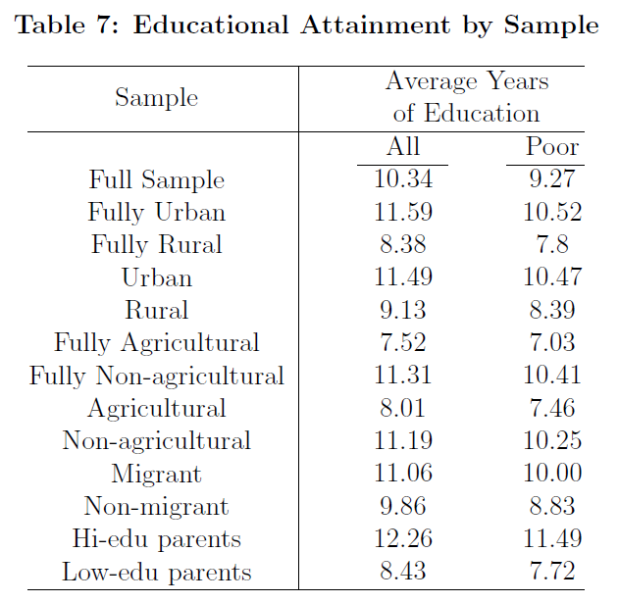
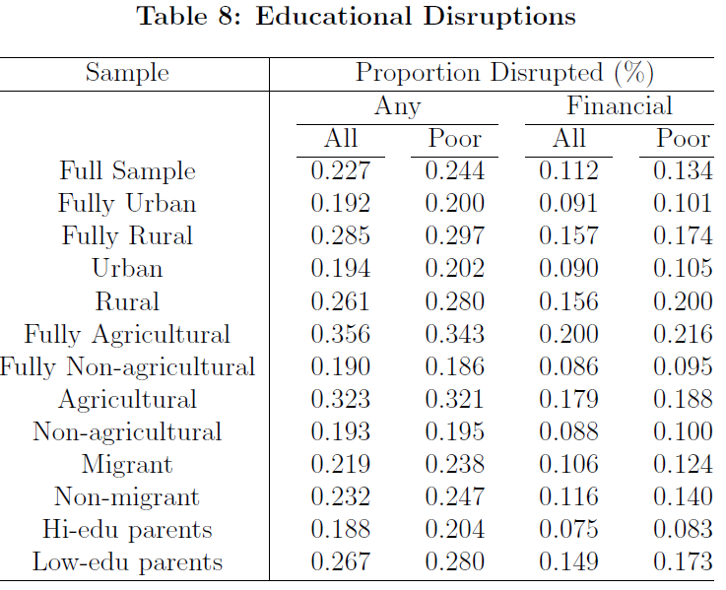
Observations—Education

Slide 15
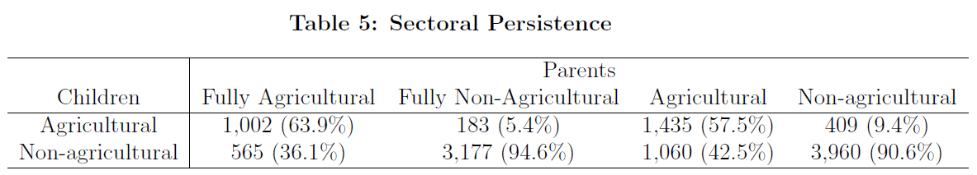
Observations—Occupational Mobility

Slide 16
Pivoting focus…
Want to explore the urban-rural gap, which leads to a few questions…
  Are people in urban places more talented or skilled?
  Are opportunities more concentrated in urban areas?
  Why don’t people living in rural areas migrate?
    Do rural-urban migrants reach the same level of success as permanent urban dwellers?
Not the first to have this idea: Lucas (2004) explores a model in this vein; idea of cities as places for learning goes back to Marshall.
Study this through the framework of intergenerational mobility

Slide 17
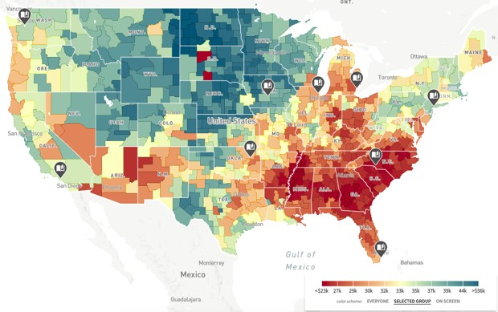
US Urban vs. Rural Mobility
In the United States, rural areas are better for upward mobility than urban areas
Higher rate of absolute upward mobility* in rural counties (44.1) compared to urban counties (42.1)—a gap of 2.0 (Chetty et al. (2018))
Does this hold in the developing world?
*expected economic outcomes of children born to a family earning an income at the 25th percentile of the national income distribution

Slide 18
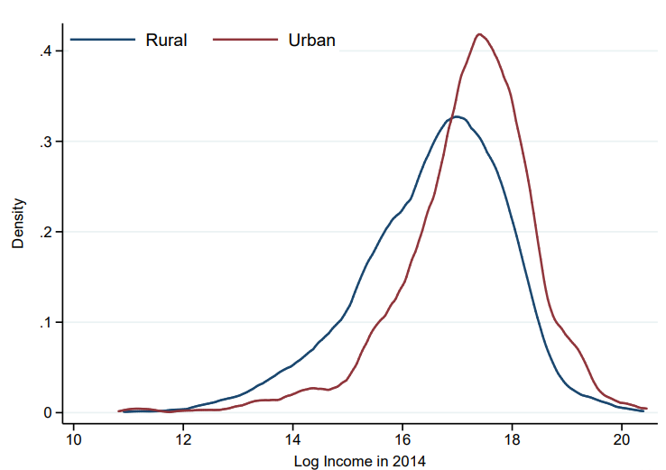
Baseline Gap in Indonesia
Those who grow up in the city in Indonesia have:
  Parent incomes 23 percentiles, or 116 log points higher
  Child incomes 13 percentiles, or 63 log points higher
Those who live in the city in 2014 have incomes 16 percentiles, or 82 log points higher

Slide 19
Migration Patterns
Child Sample:
  37% of kids who grew up in the village moved to the city
  8% of kids who grew up in the city moved to the village
For the adult sample (born on or before 1970): 27% and 6%
I partly replicate the Pulido and Swiecki result, using the 1993 and 2014 waves focusing on those born before 1970
With time but without individual FE, gap of 112 log points (SE=2)
Adding in individual FE, gap of 8 log points (SE=12)
Causal effect of moving to city is quite small

Slide 20

Intergenerational Mobility
Standard methodology: fix income distribution, then regress child income percentile on parent income percentile (Chetty et al. 2014)
  Chetty has focused on rank-rank regressions because they are almost exactly linear
I am interested in differential mobility in urban and rural areas
Requires us to establish an individual-level definition for “Urban”
  If the individual lives in an urban (rural) location for > 50% of survey observations, he is considered urban (rural).
  If the individual is urban (rural) for 50% of observations, then we use his final location.
    Same for agricultural vs. non-agricultural work

Slide 21
Absolute mobility is greater in urban than rural areas

Slide 22
Puzzle
Why is the urban-rural difference flipped in US vs Indonesia?
Hypotheses to test:
  Selection effects: higher human capital parents live/move to cities
  Public goods effects: Better schooling, healthcare
  Social effects: Better peers, role models, information about opportunities, increase aspirations etc.

Slide 23
Explaining the Puzzle
Is it due to the selection of higher human capital parents into cities?
Urban vs Rural: controlling for parents education to correct for selection
  Absolute Mobility gap remains large– especially for those lower in the income distribution
  Relative mobility gap increases
No Controls
Controlling for parent’s education

Slide 24
Explaining the Puzzle
Adding a control for child’s education
Impact comes through more than education
No Controls
Controlling for child’s education

Slide 25
Explaining the Puzzle
Could it be due to difference in educational mobility? Urban educational mobility is greater in the city versus rural areas

Slide 26
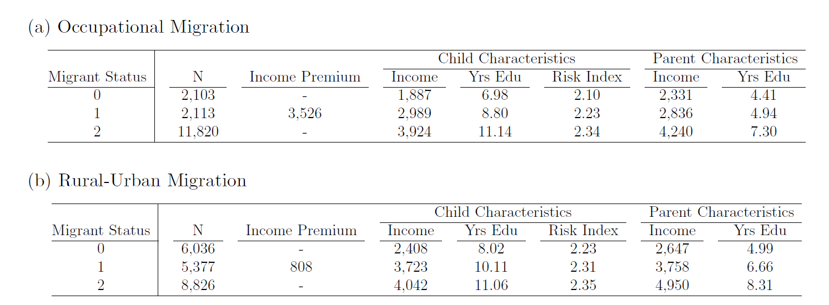
Selection into Migration
On average, rural to urban and non-agricultural to agricultural movers have higher child/parent incomes and educations, and children are more risk-friendly. However, this might just be due to additional exposure to rural/non-agricultural locations.

Slide 27
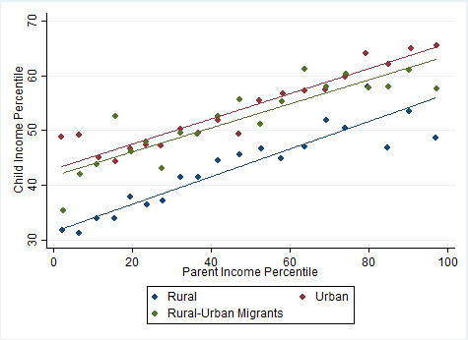
Mobility for Rural-Urban Movers
No controls
Comparable levels of relative mobility
Migrants have greater absolute mobility than rural, but lower than urban
Difference between urban and rural-urban migrants essentially disappears after controlling for own and parent’s education

Slide 28
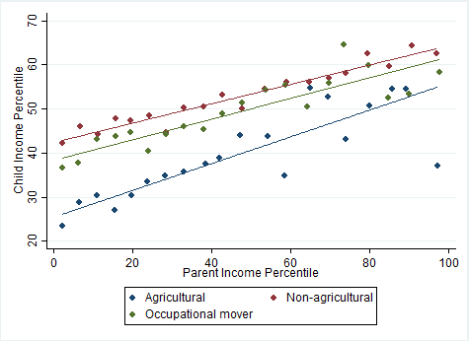
Mobility for Agricultural – Non-agricultural Movers
Similar to rural-urban comparison

Slide 29
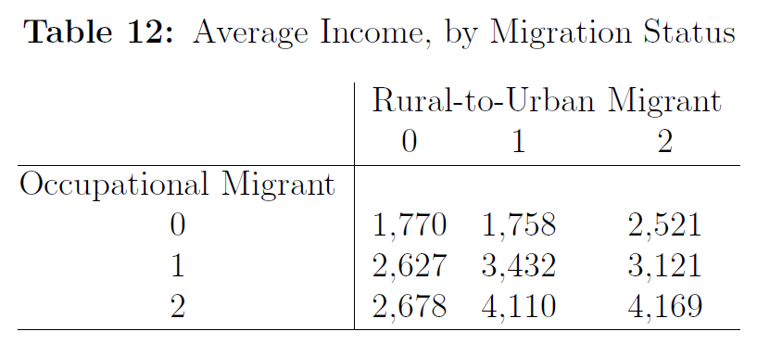
Skill-Biased Migration?
Do non-agricultural workers fare better than agricultural workers post-migration to an urban location (i.e. are there locational or occupational adjustment costs to moving?)
Those who are non-agricultural and stay non-agricultural receive barely any boost from moving to an urban area ((0,0) to (0,1)), whereas those who take non-agricultural skills (occupational migrants and always non-agricultural workers) experience significant increases in income ((1,0) to (1,1); (2,0) to (2,1))
It appears that migrants who worked in the non-agricultural sector don’t face much of an issue adjusting to the urban location (maybe easily able to find a job)
However, occupational migrants who move to urban locations DO face a bit of a job ladder. Their incomes are lower relative to those who stayed in the agricultural sector the whole time as well as those who live in urban areas the whole time.

Slide 30
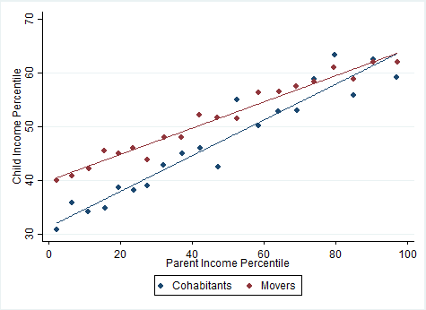
Mobility for cohabitants
Better relative and absolute mobility for those who move away from parents
Converges at the top end of the income distribution
  If you have rich parents, you end up rich by staying with your parents
Greater absolute mobility than rural, but lower than urban

Slide 31
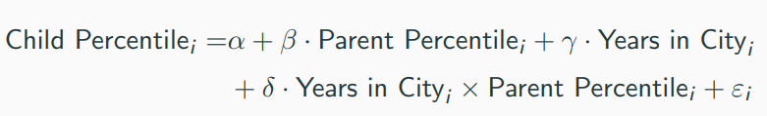
Movers Design
Follow Chetty (2017) and use a movers identification strategy to identify the causal place-based effects of cities.
Do children who move to cities have better mobility outcomes?
  Since moving is an endogenous choice, simple comparisons of the outcomes of children whose families move to different areas confound causal effects of place with selection effects (differences in unobservables).
Solution: exploiting variation in the timing of children’s moves across areas.
Compare the outcomes of children who moved to a city at different ages to determine whether there are city childhood exposure effects (whether every additional year of childhood spent in a better environment improves a child’s long-term outcomes).
Identification assumption: the selection effects (children’s unobservables) associated with moving to a city do not vary with the age of the child when the family moves.

Slide 32
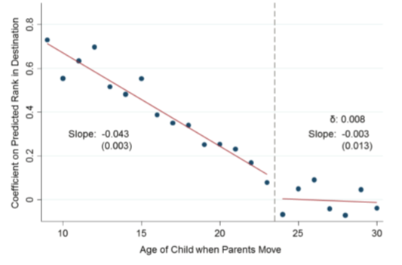
Movers Design: Chetty’s Result

Slide 33
Movers Design: Indonesia
Notes:
5,521 rural to urban parent-child pair movers

Slide 34
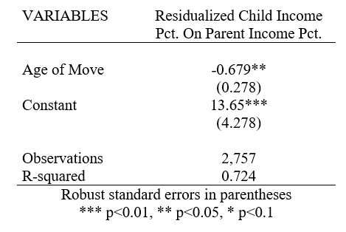
Looking at Mobility for families that move
Include rural to urban families who move before children age of 21
Family fixed effects
Exploit difference of years of exposure to the city

Slide 35
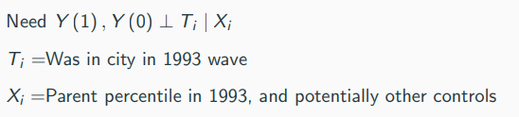
Average Treatment Effects
How do we get from that regression to a causal effect?
Want to back out ATE of growing up in the city
Will fail, for example, if, conditional on parent income:
  Heritable ability is higher in cities
  Urban parents are better parents
  Child ability causes parents to move

Slide 36
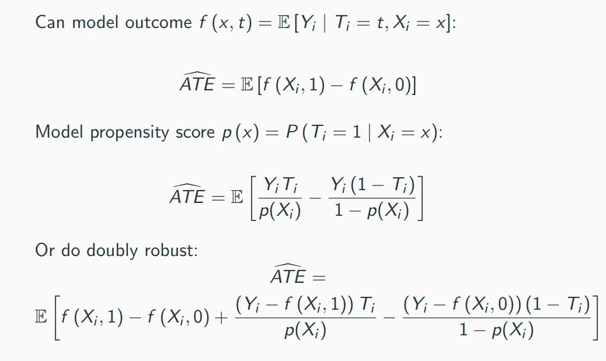
Average Treatment Effects

Slide 37
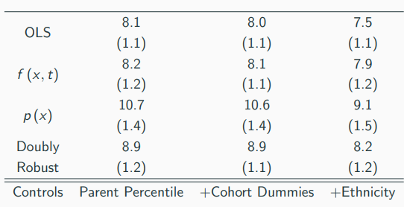
ATE on Income Percentile

Slide 38
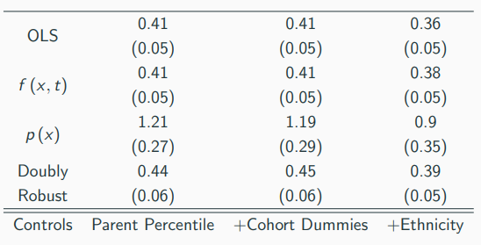
ATE on Log Income

Slide 39
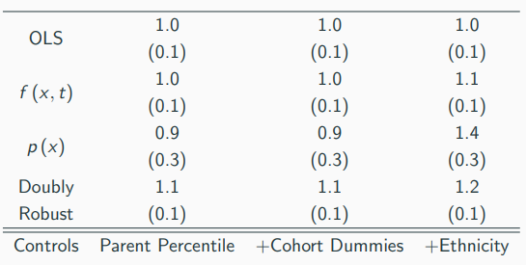
ATE on Years of Schooling

Slide 40
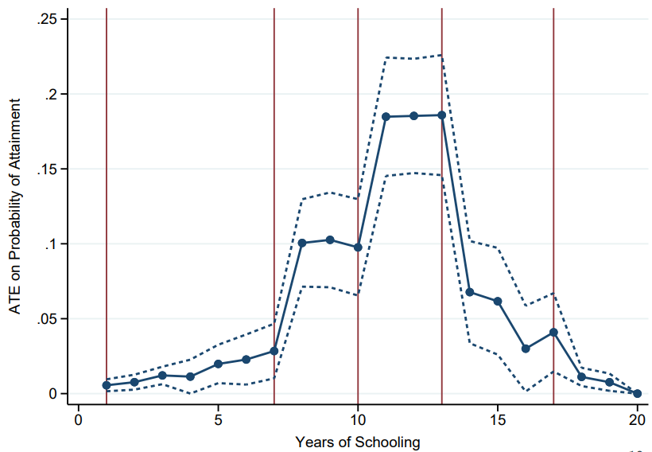
ATE on Years of Schooling

Slide 41
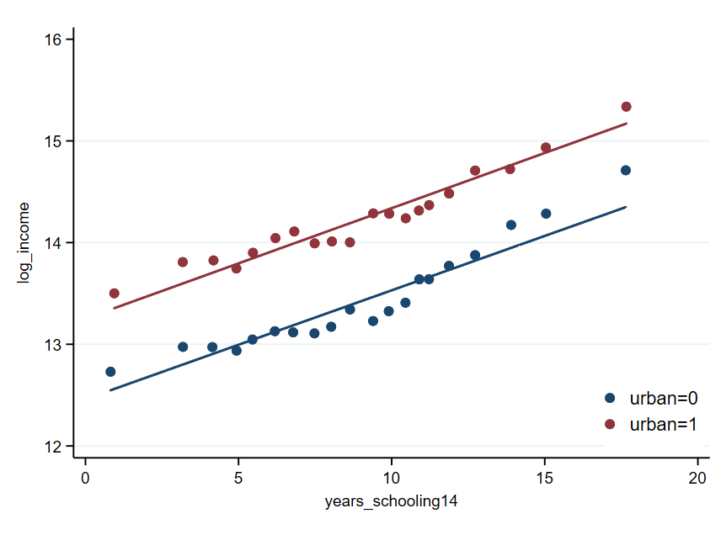
Mincer Regression: Urban vs Rural
Notes:
The percent returns to education are the same in the city vs. the village, but there is a level shift up of log income for kids growing up in the city. If all of the costs of education scale with income (this is true, for example, when the cost of education is just the opportunity cost from lost wages), then the incentives to get schooling will be unchanged. But, if there is a portion of costs that do not scale (e.g. you need to pay a fixed amount to hire a teacher of a certain quality, you need to buy books, etc.), then this will mean a greater incentive to get schooling in the city than the village.

Slide 42
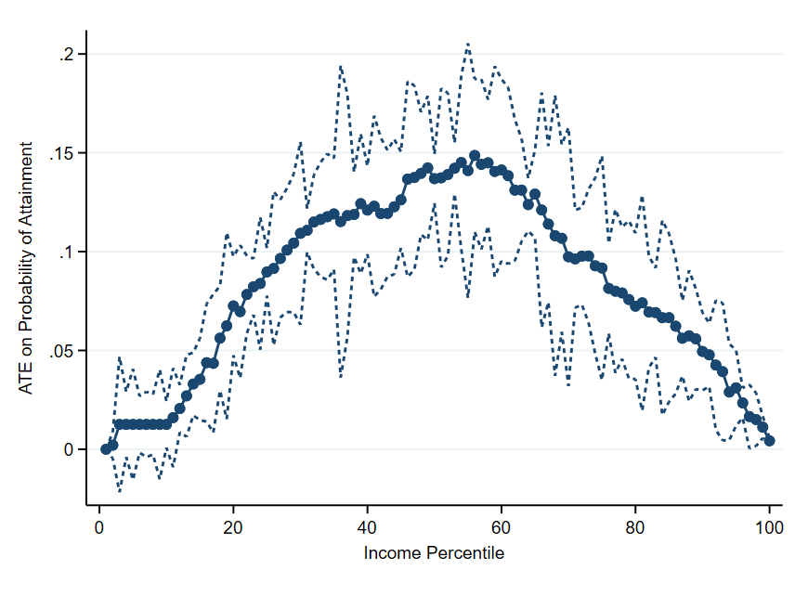
ATE on the probability of achieving at least X percentile
Notes:
Each point shows the ATE on the probability of achieving at least that percentile (in the national income distribution). The results show that there are positive effects throughout, which means that growing up in the city moves the entire distribution to the right (the distribution of potential outcomes for growing up in the city first-order stochastically dominates the distribution of potential outcomes for growing up in the village). The other thing is that the effects are strongest in the middle of the distribution: this means that growing up in the city has particularly strong effects on the probability of making it into the middle class.

Slide 43
Next steps
Coming - link geocoded community survey data to individuals
Variables I’ll use
  Public education: % of teachers trained, and distance from school
  Health care services: range of quality indicators (still trying to figure out what kind of proxy of this makes sense), and distance
  Public health: clean public/private toilets and sanitation (sewage and garbage maintenance)
  Public facilities: whether have paved road, bus station, and tap water in their neighborhoods/village
Add further robustness to the ATEs
Understand the education/human capital aspect better by:
  Looking at community level characteristics (e.g. distance from school, school quality, etc.)
  Looking at impacts on cognitive capacity, health and on the personality related questions (the latter representing non-cognitive skills)
  Thinking a bit more about the implications of the mincer regressions (returns to education for rural vs. urban kids)

Slide 44
Next steps
Look at heterogeneous effects by race
Potentially extend to other countries, focusing on other settings with high quality linked data on parent and child income
Look at consumption
Compare people who move rural to urban vs rural to rural controlling for public goods provision if possible?
  Isolate social/peer effects by controlling for parent observables
Use “why did you move” variable to identify “random” moves
Use improvement in public transport/building of road as instrument for migration/variation?
  Interact with distance to city?
Look at distance to city, population density relationship with mobility
Other Indonesian natural experiments
Additional outcomes (cognitive capacity, personality, health), additional controls (parent education, religion, and language)
Bring in census data to increase power: Can estimate propensity score in the census, then use that to compute ATE in IFLS

Slide 45
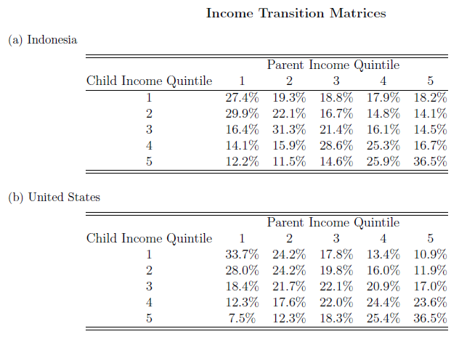
Appendix

